Slide 1
Java Introduction
Created By Rahul Majukar

Slide 2

What is java?
Subscribe
HackifyTech
Like & Follow
It is an object-oriented language similar to C++, but with advanced and simplified features. This language is free to access and can run on all platforms.
It is owned by Oracle, and more than 3 billion.
Java is a high level, robust, object-oriented and secure programming language.
Java is: –
Concurrent where you can execute many statements instead of sequentially executing it.
Class-based and an object-oriented programming language.
Independent programming language that follows the logic of “Write once, Run anywhere” i.e. the compiled code can run on all platforms which supports java.

Slide 3
Why to use java?
Subscribe
HackifyTech
Like & Follow
Java works on different platforms (Windows, Mac, Linux, Raspberry Pi, etc.)
It is one of the most popular programming language in the world
It has a large demand in the current job market
It is easy to learn and simple to use
It is open-source and free
It is secure, fast and powerful
It has a huge community support (tens of millions of developers)
Java is an object oriented language which gives a clear structure to programs and allows code to be reused.

Slide 4
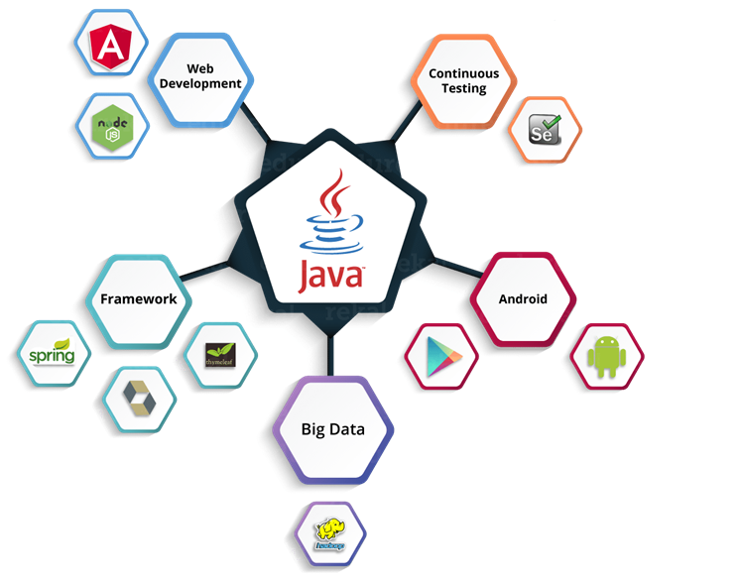
When Use Java? (Applications)
Subscribe
HackifyTech
Like & Follow
Desktop Applications.
Web Applications.
Enterprise Applications.
Mobile.
Embedded System.
Smart Card.
Robotics.
Games, etc.

Slide 5

History of Java
Subscribe
HackifyTech
Like & Follow
Java was created at Sun Microsystems
Java was developed by James Gosling, who is known as the father of Java, in 1995.
Initially it was designed for small, embedded systems in electronic appliances like set-top boxes.
The latest version of Java is Java 22 or JDK 22

Slide 6
Features of java
Subscribe
Like & Follow
HackifyTech
Simple
Java is very easy to learn, and its syntax is simple, clean and easy to understand.
Java syntax is based on C++

Slide 7

Features of Java
Subscribe
Like & Follow
HackifyTech
Object-Oriented
Everything in Java is an object.
Object-oriented means we organize our software as a combination of different types of objects that incorporate both data and behaviour.
simplifies software development and maintenance

Slide 8



Features of Java
Subscribe
Like & Follow
HackifyTech
Platform Independent
A platform is the hardware or software environment in which a program runs.
How java is independent: Java code is compiled by the compiler and converted into bytecode. This bytecode is a platform-independent code because it can be run on multiple platforms, i.e., Write Once and Run Anywhere (WORA).
Written in windows
Can be executed in widows
Java code (.java)
Javac compiler
Byte code (.class)
JVM
bytecode
Can be executed in linux
Can be executed in IOS

Slide 9

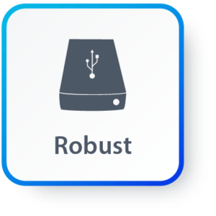
Features of Java
Subscribe
Like & Follow
HackifyTech
Secure
With Java, we can develop virus-free systems.
Java Programs run inside a virtual machine sandbox
All the code is converted in bytecode after compilation, which is not readable by a human
Robust
Java provides automatic garbage collection.
Java has a strong memory management system. It helps in eliminating error as it checks the code during compile and runtime.

Slide 10
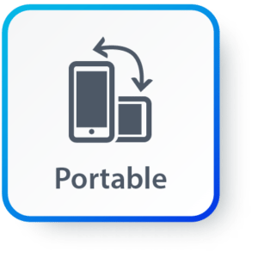
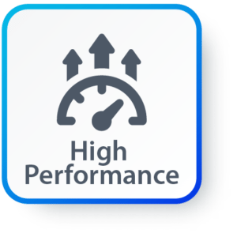
Features of Java
Subscribe
Like & Follow
HackifyTech
Portable:
Java let you to carry the Java bytecode to any platform.
High Performance:
With the use of JIT (Just-In-Time) compilers, it enables high performance.

Slide 11
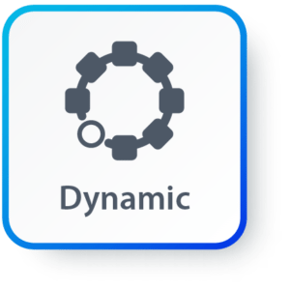
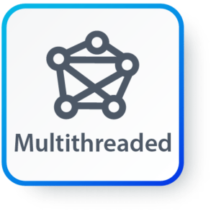
Features of Java
Subscribe
Like & Follow
HackifyTech
Dynamic:
It supports the dynamic loading of classes. It means classes are loaded on demand.
Multi-threaded
A thread is like a separate program, executing concurrently. We can write Java programs that deal with many tasks at once by defining multiple threads.

Slide 12
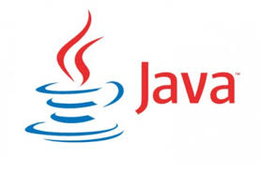
Java Installation
Subscribe
Like & Follow
HackifyTech
Download Java for Windows 10
Go to: Java Downloads | Oracle India
Download .exe file.
Install Java on Windows 10
Run the Downloaded File(double click).
Configure the Installation Wizard
Click next → next → close

Slide 13
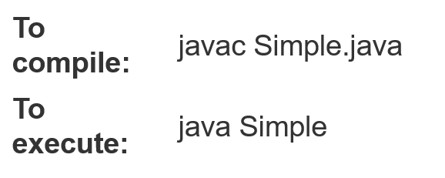
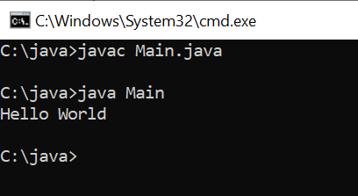
Java Installation
Subscribe
Like & Follow
HackifyTech
Save the code in Notepad as "Main.java".
Open Command Prompt (cmd.exe), navigate to the directory where you saved your file,
type "javac Main.java“ hit enter, this command will compile the code,
If any error in code while displayed in the console else nothing is displayed.
Now give “java Main” this will execute your code and shows you the output in console.
Point to remember:
Java is case-sensitive

Slide 14
Hello World java program
Subscribe
Like & Follow
HackifyTech
This reserved keyword is used to define a class in Java.
public class Main{
public static void main(String args[]) {
System.out.println(“Hello World”);
}
}
User defined class name
This is an access modifier that means this class & method is accessible by any other class.
entry point of the program.
method does not return any value.
Array of string object
allows the JVM to call the method without creating an instance of the class.

Slide 15
Structure of System.out.println()
Subscribe
Like & Follow
HackifyTech
System is predefined final class in the java.lang package
println() is a method, prints the message in the console
System.out.Println(“Hello World”);
It’s an instance(object) of PrintStream.
String message that shown on console(prameters)

Slide 16
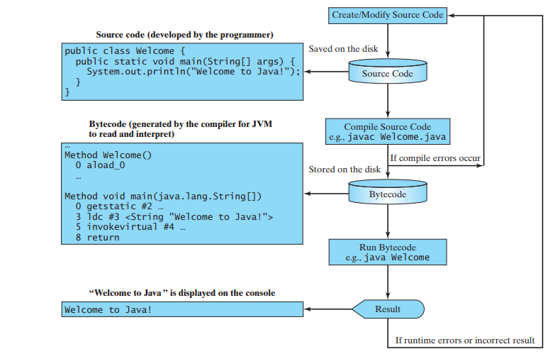
Compiling and Executing a Java Program
Subscribe
Like & Follow
HackifyTech

Slide 17
Eclipse installation
Subscribe
Like & Follow
HackifyTech

Slide 18
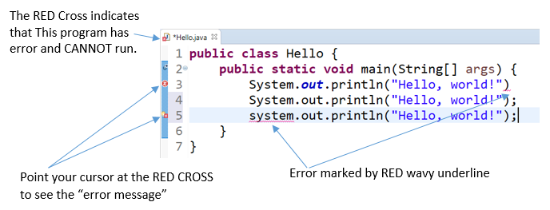
Eclipse installation
Subscribe
Like & Follow
HackifyTech

